Slide 1

Hunter x Hunter or Made in Abyss?
A User-Empowered Anime Recommender System
Binh Hoang

Slide 2





Anime Streaming War
Global anime market valued at $20 bn in 2018 and growing

Slide 3
Recommender Systems as Competitive Edge
Crunchyroll’s first recommender system (2020)

Slide 4



Data
ANIME RATINGS
FROM 120,000 USERS
1,000
TOP ANIME

Slide 5




Methodology
Web Scrape
Data Storage
Recommender
Visualization

Slide 6
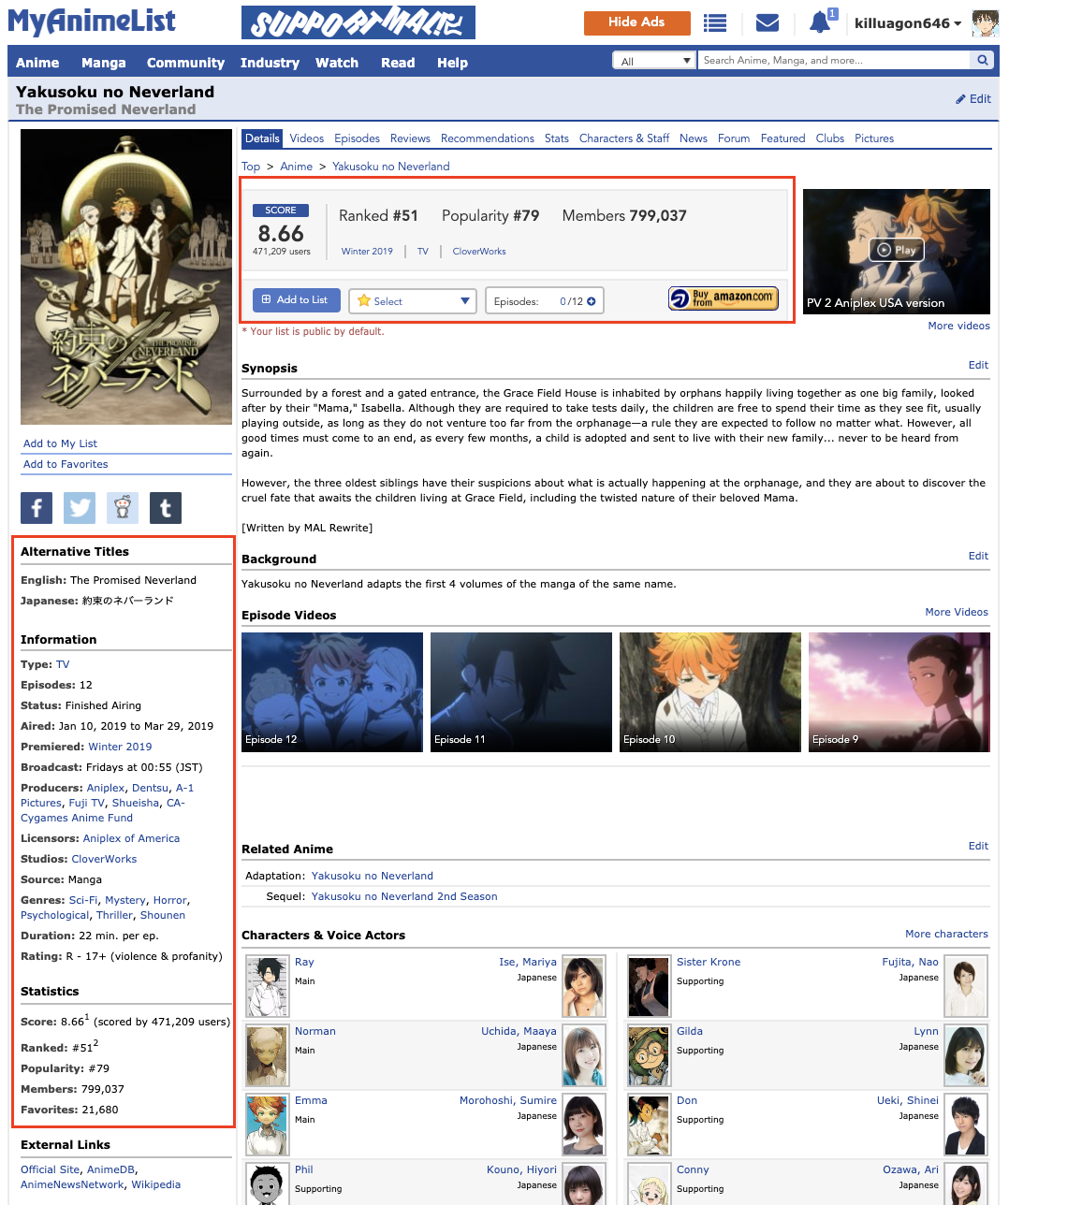
Hybrid Recommender System
Content-based Filtering
Collaborative Filtering
Anime
Features
Anime
Features
=
Users
Users

Slide 7




Recommender System Pipeline
Anime A: 10 points
Anime B: 6 points
Anime C: 12 points
.
.
.
Anime T: 8 points
Anime C: 12 points
Anime A: 10 points
Anime T: 8 points
.
.
.
Anime B: 6 points
Content-based Filtering
10 anime
20 anime
10 anime
10 anime
Collaborative
Filtering
1,000
TOP ANIME
CANDIDATE GENERATION
SCORING
RE-RANKING
RECOMMENDATION

Slide 8





User alesyasabri1 Anime Profile
alesyasabri1
Watches a lot of shounen anime (66%)

Slide 9

Content-based Filtering
Kuroko No Basuke
(another shounen anime)

Slide 10

Collaborative Filtering
Mo Dao Zu Shi
(visually stunning mature action anime)

Slide 11
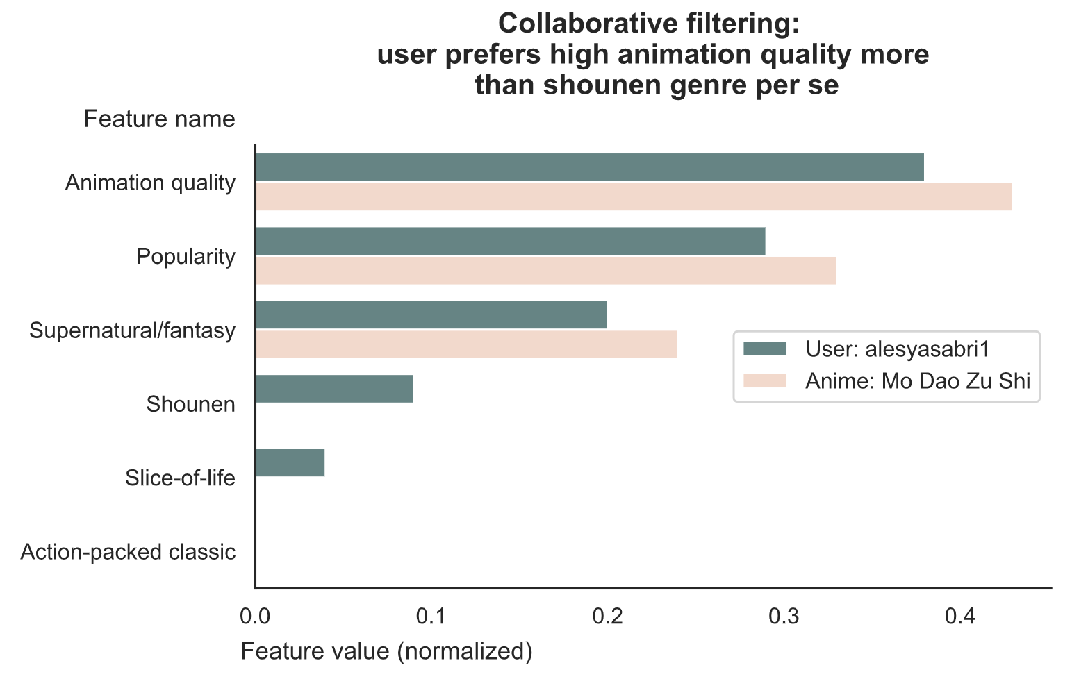
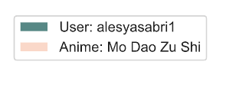

Slide 12



Empower Users
Less Adventurous
(content-based filtering)
Balanced
(mix of both)
More Adventurous
(collaborative filtering)

Slide 13

Thank you
Binh Hoang
LinkedIn: binh748
GitHub: binh748
Images/data were sourced from the internet for educational purposes

Slide 14
Methodology
Web Scraping
Data Storage
Recommender
Visualizations
BeautifulSoup
Selenium
Docker
Google Cloud Platform
MongoDB
Scikit-learn
Pandas
Numpy
Seaborn
Flask (HTML/CSS)

Slide 15
Hybrid Recommender System
 | Content-based Filtering | Collaborative Filtering
Method | User embedding is average of anime features for anime user has watched | NMF (non-negative matrix factorization) to learn latent features for user/anime embeddings
Features | Genre Media type (e.g. TV, movie, ONA) Content-rating (e.g. PG, PG-13, R) Number of episodes Average user score Number of members (aka followers) Age (i.e. years since premiere) | Animation quality Popularity Supernatural/fantasy Shounen Slice-of-life Action-packed classic
Distance Metric | Cosine similarity | Cosine similarity

Slide 16
Future Work
Collate anime seasons/movies of a single anime into one listing so not recommending the same anime repeatedly (explain what I mean with an example)

